Slide 1
Chapter 8
Scheduling

Slide 2
Useful Abbreviations
CPM - Critical Path Method
PERT - Program Evaluation and Review Technique
8-<number>

Slide 3
Background (Slide 1 of 2)
Schedule is the conversion of a project action plan into an operating timetable
Basis for monitoring a project
One of the major project management tools
Work changes daily, so a detailed plan is essential
Not all project activities need to be scheduled at the same level of detail
8-<number>

Slide 4
Background (Slide 2 of 2)
Most of the scheduling is at the WBS level, not the work package level
Only the most critical work packages may be shown on the schedule
Most of the scheduling is based on network drawings
8-<number>

Slide 5
Network Scheduling Advantage (Slide 1 of 2)
Consistent framework
Shows interdependences
Shows when resources are needed
Ensures proper communication
Determines expected completion date
Identifies critical activities
8-<number>

Slide 6
Network Scheduling Advantage (Slide 2 of 2)
Shows which of the activities can be delayed
Determines start dates
Shows which task must be coordinated
Shows which task can be run parallel
Relieves some conflict
Allows probabilistic estimates
8-<number>

Slide 7
Network Scheduling Techniques:
PERT (ADM) and CPM (PDM)
PERT was developed for the Polaris missile/submarine project in 1958
CPM developed by DuPont during the same time
Initially, CPM and PERT were two different approaches
  CPM used deterministic time estimates and allowed project crunching
  PERT used probabilistic time estimates
Microsoft Project (and others) have blended CPM and PERT into one approach
8-<number>

Slide 8
Terminology (Slide 1 of 3)
Activity - A specific task or set of tasks that are required by the project, use up resources, and take time to complete
Event - The result of completing one or more activities
Network - The combination of all activities and events that define a project
  Drawn left-to-right
  Connections represent predecessors
8-<number>

Slide 9
Terminology (Slide 2 of 3)
Path - A series of connected activities
Critical - An activity, event, or path which, if delayed, will delay the completion of the project
Critical Path - The path through the project where, if any activity is delayed, the project is delayed
  There is always a critical path
  There can be more than one critical path
8-<number>

Slide 10
Terminology (Slide 3 of 3)
Sequential Activities - One activity must be completed before the next one can begin
Parallel Activities - The activities can take place at the same time
Immediate Predecessor - That activity that must be completed just before a particular activity can begin
8-<number>

Slide 11

Sequential Activities
8-<number>

Slide 12
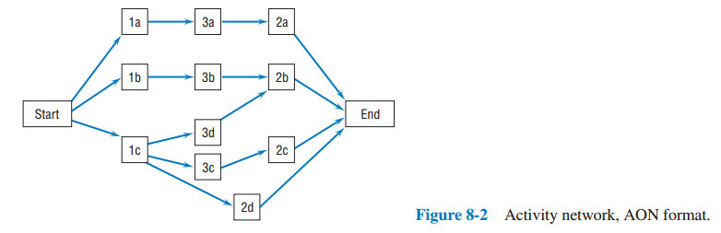
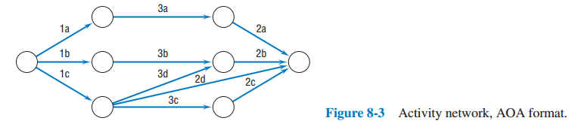
AON and AOA Format
8-<number>

Slide 13
Constructing the Network
Begin with START activity
Add activities without precedences as nodes
  There will always be one
  May be more
Add activities that have those activities as precedences
Continue
8-<number>

Slide 14
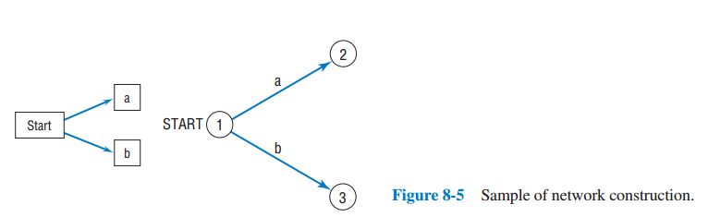
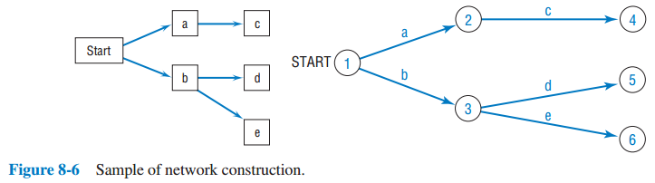
Sample of Network Construction
8-<number>

Slide 15
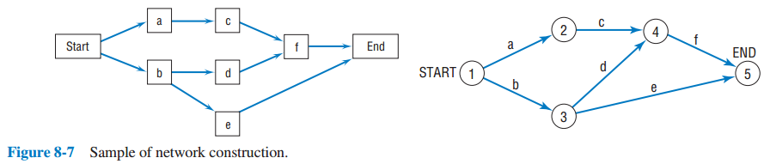
Sample of Network Construction
8-<number>

Slide 16
Gantt (Bar) Charts
Developed by Henry L. Gantt
Shows planned and actual progress
Easy-to-read method to know the current status
8-<number>

Slide 17
Advantages and Disadvantage
Advantages
  Easily understood
  Provide a picture of the current state of a project
Disadvantage
  Difficult to follow complex projects
8-<number>

Slide 18
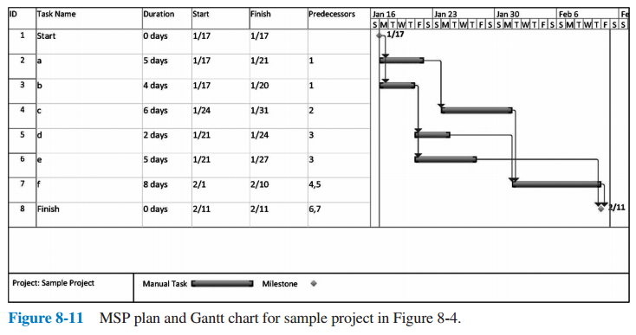
Microsoft Project Gantt Chart
8-<number>

Slide 19
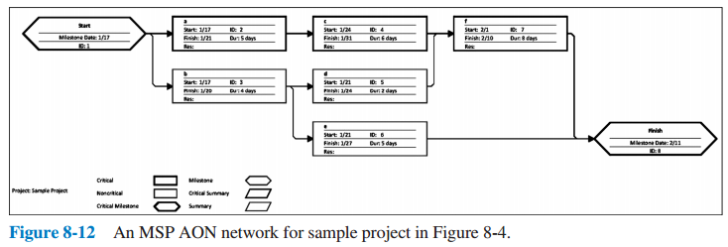
Microsoft Project AON Network
8-<number>

Slide 20
An Important Aside on Estimating Activity Times
It is vital to good project management to be meticulously honest in estimating the time required to complete each of the various tasks included in the project
No false deadlines
Evaluate alternative ways of completing work.
8-<number>

Slide 21
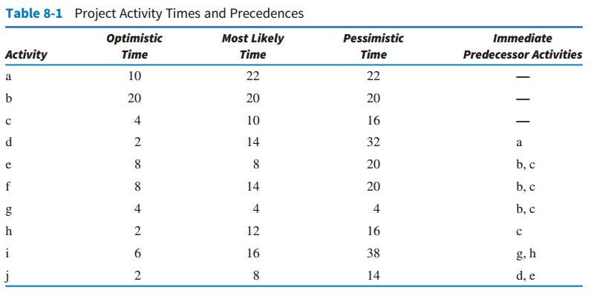
Solving the Network
8-<number>

Slide 22
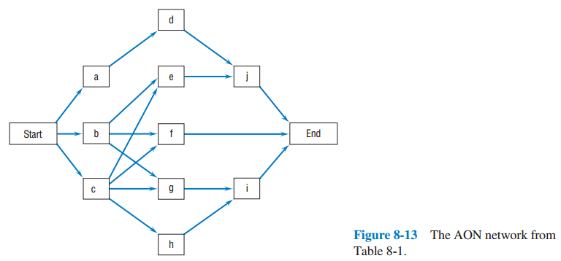
The AON Network From The Previous Table
8-<number>

Slide 23
Calculating Activity Times
Use three time estimates:
  Optimistic
  Pessimistic
  Most likely
8-<number>

Slide 24
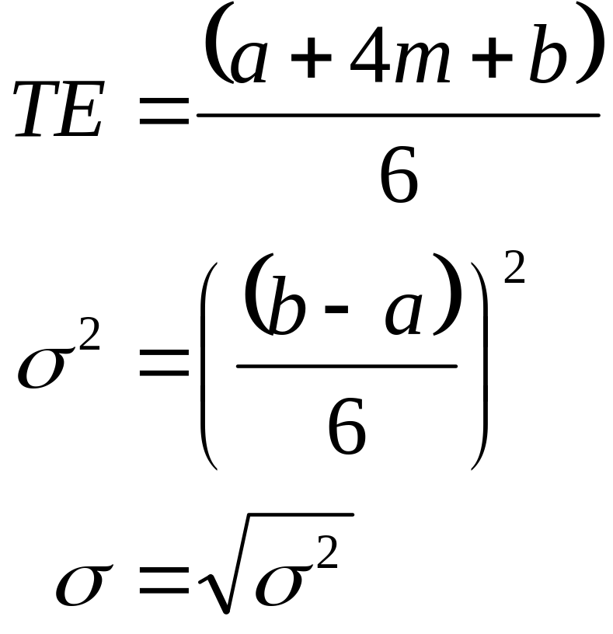
Calculating Activity Times
8-<number>

Slide 25
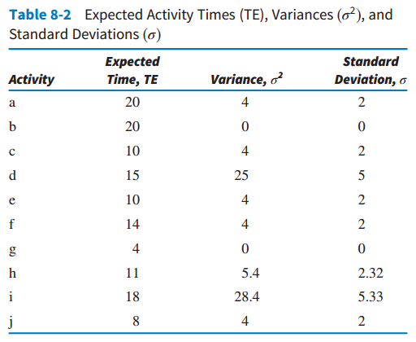
The Results
8-<number>

Slide 26
Parkinson’s Law
Work expands to fill the allotted time
8-<number>

Slide 27
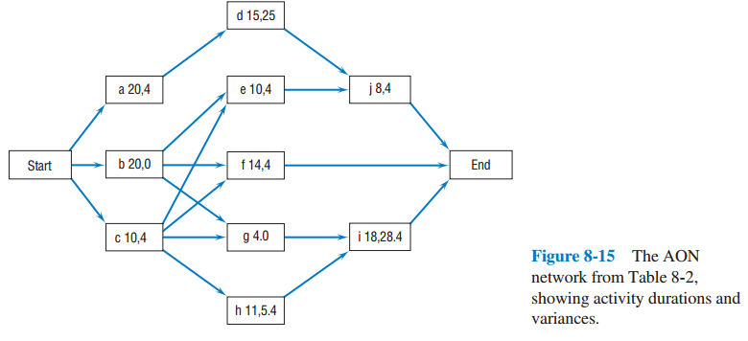
Critical Path and Time (Slide 1 of 2)
8-<number>

Slide 28
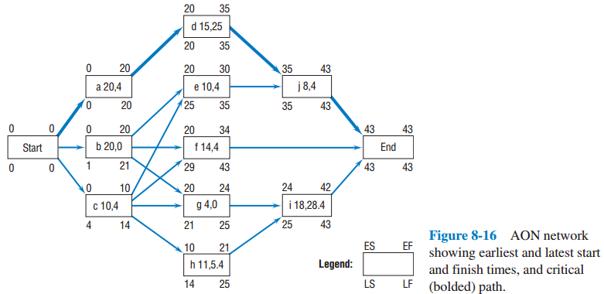
Critical Path and Time (Slide 2 of 2)
8-<number>

Slide 29
Slack (aka, Float)
LS - ES or LF - EF
8-<number>

Slide 30
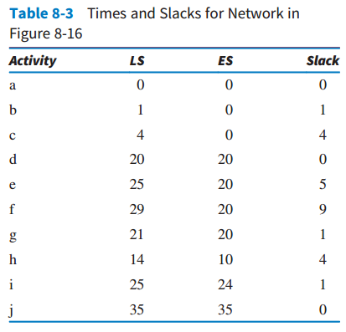
Slack Values
8-<number>

Slide 31
Precedence Diagramming Restrictions
Finish to start
Start to start
Finish to finish
Start to finish
8-<number>

Slide 32
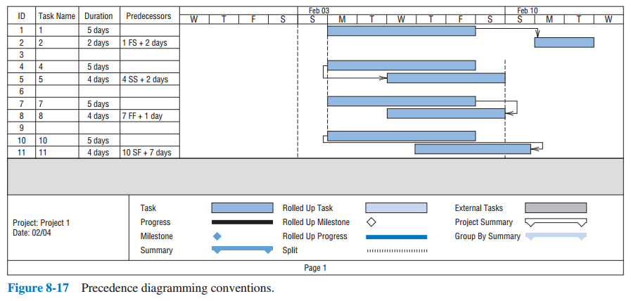
Precedence Diagramming Conventions
8-<number>

Slide 33
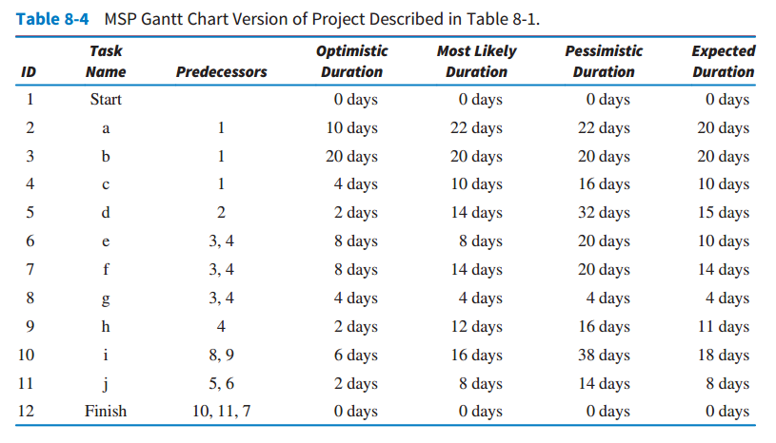
Microsoft Project
8-<number>

Slide 34
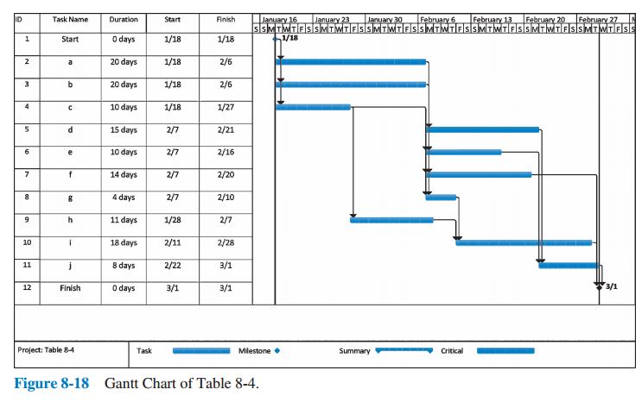
Gantt Chart
8-<number>

Slide 35
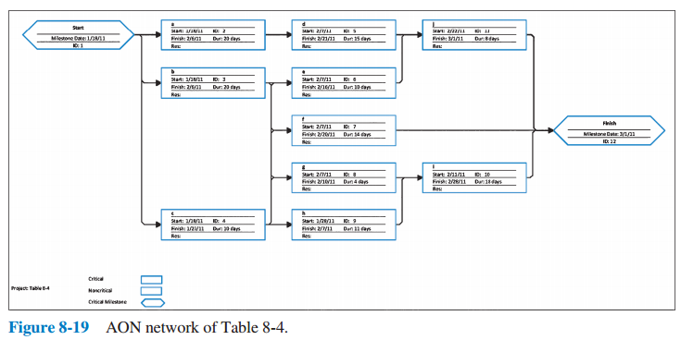
AON Network
8-<number>

Slide 36
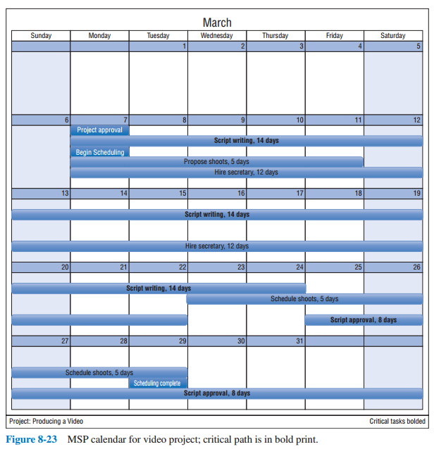
Microsoft Project Calendar
8-<number>

Slide 37
Uncertainty of Project Completion Time
Assume activities are statistically independent
Variance of a set of activities is the sum of the individual variances
Interested in variances along the critical path
8-<number>

Slide 38
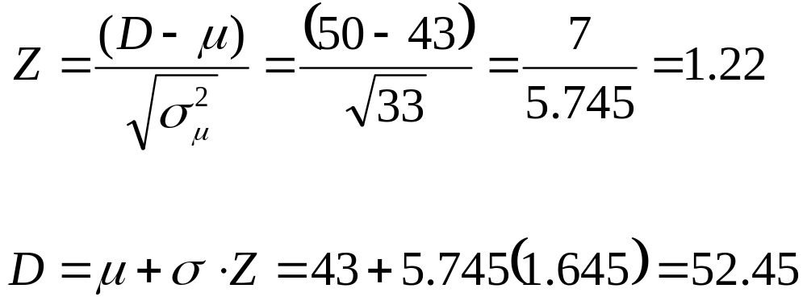
Example
8-<number>

Slide 39
Toward Realistic Time Estimates
Calculations are based on 1% chance of beating estimates
Calculations can also be based on 5% or 10%
Changing the percentage requires changing the formulae for variance
When using 5%, the divisor changes to 3.29
When using 10%, the divisor changes to 2.56
8-<number>

Slide 40
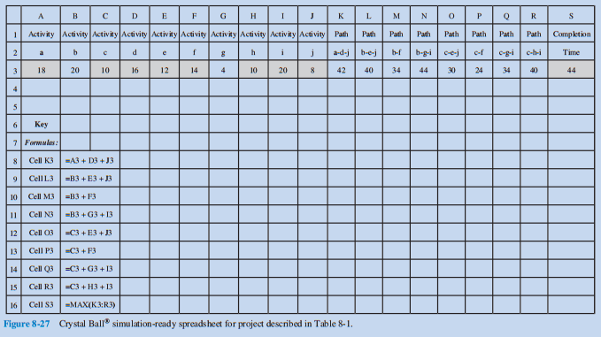
Risk Analysis Using Simulation with Crystal Ball
8-<number>

Slide 41
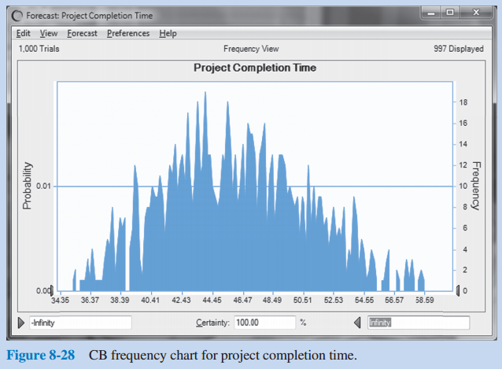
Risk Analysis Using Simulation with Crystal Ball
8-<number>

Slide 42
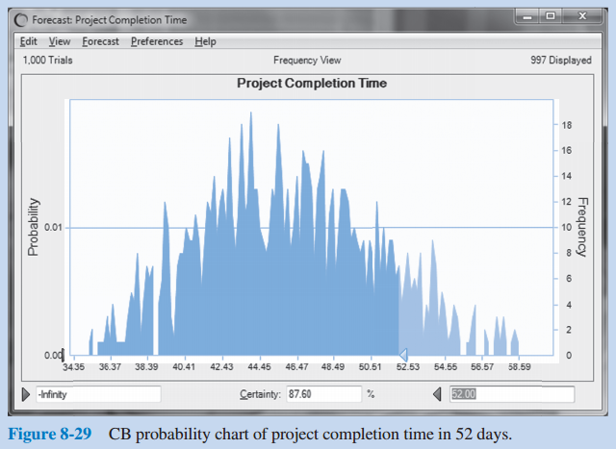
Risk Analysis Using Simulation with Crystal Ball
8-<number>

Slide 43
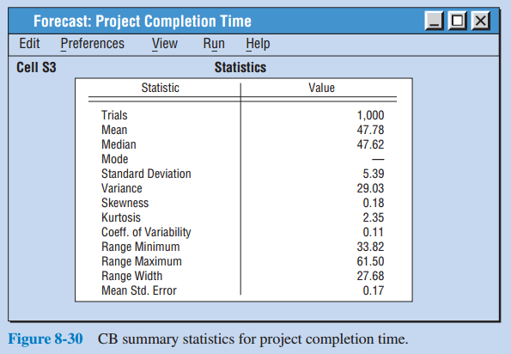
Risk Analysis Using Simulation with Crystal Ball
8-<number>

Slide 44
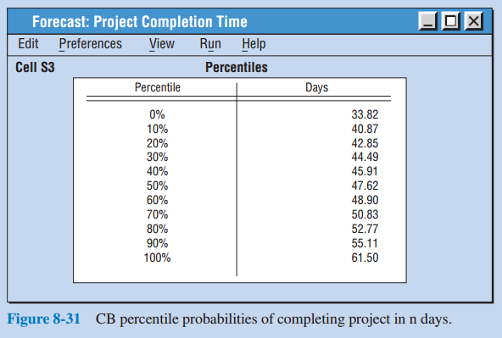
Risk Analysis Using Simulation with Crystal Ball
8-<number>

Slide 45
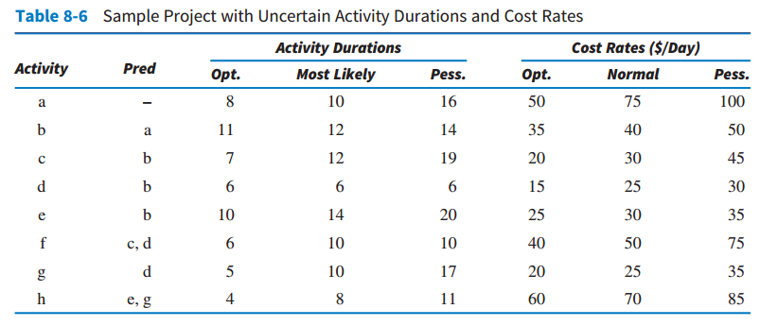
Incorporating Costs into the Simulation Analysis
8-<number>

Slide 46
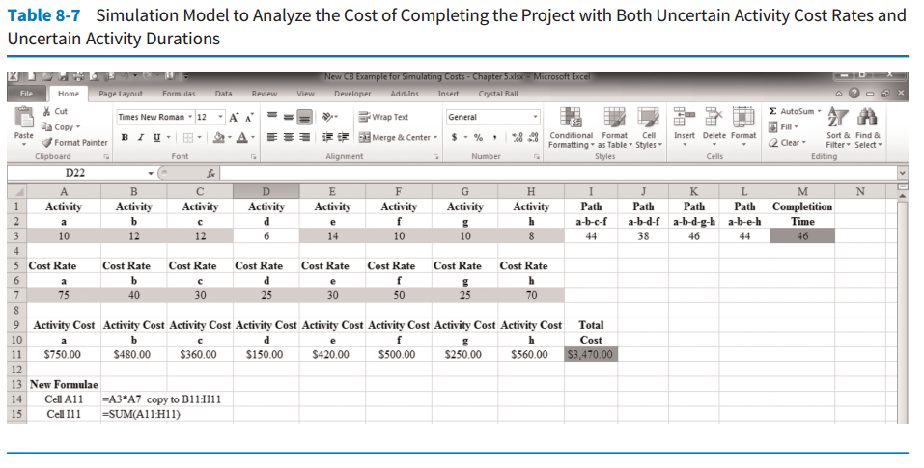
Incorporating Costs into the Simulation Analysis
8-<number>

Slide 47
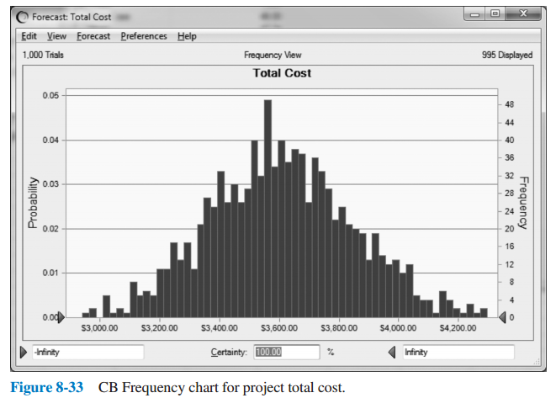
Incorporating Costs into the Simulation Analysis
8-<number>

Slide 48
Traditional Statistics or Simulation?
Simulation is recommended but only after the analyst has a good understanding of the traditional statistical approach.
Important for project manager to manage all paths and activities that may potentially impact the project’s ability to be completed on time
  Even non-critical tasks
8-<number>

Slide 49
Using These Tools
Microsoft Project®
Crystal Ball®
Excel®
8-<number>

Slide 50
Copyright
Copyright © 2018 John Wiley & Sons, Inc.
All rights reserved. Reproduction or translation of this work beyond that permitted in Section 117 of the 1976 United States Act without the express written permission of the copyright owner is unlawful. Request for further information should be addressed to the Permissions Department, John Wiley & Sons, Inc. The purchaser may make back-up copies for his/her own use only and not for distribution or resale. The Publisher assumes no responsibility for errors, omissions, or damages, caused by the use of these programs or from the use of the information contained herein.
Copyright ©2018 John Wiley & Son, Inc.

